Slide 1
Understanding ARM Instruction Set Architecture (ISA) using ARM Simulator
Dr. Hari T.S. Narayanan
Notes:
Pre-requisite: A good understanding of one of the processor architecture!
Objective of this presentation is two fold:
Learn ARM ISA
Learn to write code with ARM ISA

Slide 2
Importance of Instruction Set
Computer Architecture and Computer Organization are two related courses, however, their objectives are different
  Computer Organization presents how various components (Memory, ALU, I/O Ports, Bus, etc) of a Microprocessor can be designed and developed
    Computer Organization course describes the design and development of individual components of a processor.
Computer Architecture course on the other hand, describes various interfaces within and to a Microprocessor
  Describes the interfaces between various components within a Microprocessor
  Describes programmers’ interface to a Microprocessor using Instruction Set Architecture (ISA)
Notes:
High end Programmers who develop compilers, Kernels, Drivers, VMs, Interpretters, libraries, performance enhancing codes

Slide 3
The ARM Instruction Set Architecture
(Acknowledgement: A large volume of the following material is taken from ARM University)

Slide 4
Advanced RISC Machine (ARM)
ARM stands for Advanced RISC Machine
ARM family includes 8/16/32/64 bits processors
Different versions of ARM processors share the same machine Instruction Set
We will be studying 32-bit ARM processor using a ARM Simulator application, ARMSim#
ARMSim# © R. N. Horspool, W. D. Lyons, M. Serra Department of Computer Science, University of Victoria
Notes:
A32 (or ARM): a 32-bit fixed length instruction set, enhanced through the different architecture variants. Part of the 32-bit architecture execution environment now referred to as AArch32.
T32 (Thumb) introduced as a 16-bit fixed-length instruction set, subsequently enhanced to a mixed-length 16- and 32-bit instruction set on the introduction of Thumb-2 technology. Part of the 32-bit architecture execution environment now referred to as AArch32.
A64 is a 64-bit fixed-length instruction set that offers similar functionality to the ARM and Thumb instruction sets. Introduced with ARMv8-A, it is the AArch64 instruction set.

Slide 5
Main features of the
ARM Instruction Set
All instructions are 32 bits long. ARM processor supports 8/16/32/64 bits data values
ARM processor executes instructions in a 3-Stage pipeline.
Most of the ARM instructions executed in a single cycle.
Every instruction can be conditionally executed.
ARM uses load/store architecture
  Data processing instructions act only on registers (Register-Register Architecture)
    Three operand format
    Combined ALU and barrel shifter for high speed bit manipulation
  Specific memory access instructions with powerful auto-indexing addressing modes.
    32 bit and 8 bit data types and also 16 bit data types on ARM Architecture v4.
    Flexible multiple register load and store instructions

Slide 6
Processor Modes
The ARM has six operating modes:
  User (unprivileged mode under which most tasks run)
  FIQ (entered when a high priority (fast) interrupt is raised)
  IRQ (entered when a low priority (normal) interrupt is raised)
  Supervisor (entered on reset and when a Software Interrupt instruction is executed)
  Abort (used to handle memory access violations)
  Undef (used to handle undefined instructions)
Notes:
Why modes: Multiple modes are created to enable different behaviour of the Microprocessor with minimum delay. Simply by changing the mode to Supervisory mode, certain privileged instructions could be executed. If different modes were not there such execution will invoice too much overhead!
Use Multipurpose furniture as an example to explain the modes of a processor

Slide 7
Addressing
ARM includes capability to address byte, half word, and full word (32 bits)
ARM instructions are always 32 bits in size, data can be of 8/16/32 bits
This means, byte addresses of instructions start from 0 and increase in steps 4: 0, 4, 8, and so on
Program Counter is initialized to 0 when the processor is reset, and increases in steps of 4
This means, the least significant 2 bits of PC are always 0
This reduces the number of bits required to store address and address offset of instructions with in programs;
Such optimization does not work for data!

Slide 8







Registers and Register Banks
37 Registers
r0-r12,sp-um, lr-um, pc, cpsr
r0-r12,sp-sm, lr-sm, pc, cpsr, spsr-sm
18 General Purpose Registers: r0 – r12, r8fm-r12fm (fm stands of FIQ Mode)
6 Stack Pointer (sp): sp-xx
6 Link Register (lr): lr-xx
1 Program Counter: pc
1 Current Program Status Register: cpsr
5 Saved Program Status Register: spsr-xx
User mode (um)
Bank – 17 regs
Supervisor mode (sm)
Bank – 18 regs
r0-r7, r8fm-r12fm,sp-fm, lr-fm, pc, cpsr, spsr-fq
r0-r12,sp-nm, lr-nm, pc, cpsr, spsr-nm
FIQ mode (fm)
Bank – 18 regs
Undefined mode (nm)
Bank – 18 regs
r0-r12,sp-im, lr-im, pc, cpsr, spsr-im
r0-r12,sp-am, lr-am, pc, cpsr, spsr-am
IRQ mode (im)
Bank – 18 regs
Abort mode (am)
Bank – 18 regs
6 Register Banks
Notes:
This slide shows the registers visible in each mode - basically in a more static fashion than the previous animated slide that is more useful for reference.
The main point to state here is the splitting of the registers in Thumb state into Low and High registers.
ARM register banking is the minimum necessary for fast handling of overlapping exceptions of different types (e.g. ABORT during SWI during IRQ). For nested exceptions of the same type (e.g. re-entrant interrupts) some additional pushing of registers to the stack is required.

Slide 9
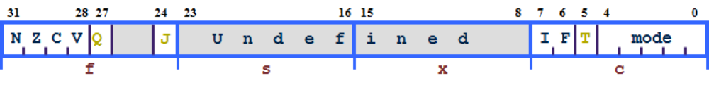
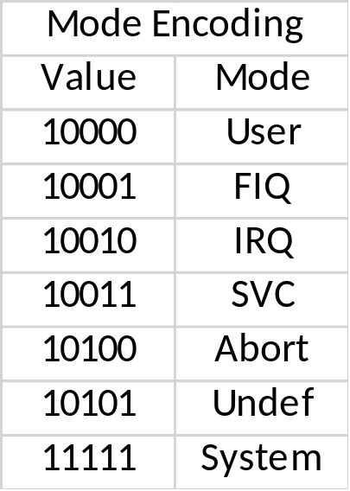
Program Status Registers
Condition code flags
  N = Negative result from ALU
  Z = Zero result from ALU
  C = ALU operation Carried out
  V = ALU operation oVerflowed
Interrupt Disable bits.
  I = 1: Disables the IRQ.
  F = 1: Disables the FIQ.
Mode bits
  Specify the processor mode
Notes:
Green psr bits are only in certain versions of the ARM architecture
ALU status flags (set if "S" bit set, implied in Thumb state).
Sticky overflow flag (Q flag) is set either when
saturation occurs during QADD, QDADD, QSUB or QDSUB, or
the result of SMLAxy or SMLAWx overflows 32-bits
Once flag has been set can not be modified by one of the above instructions and must write to CPSR using MSR instruction to cleared
PSRs split into four 8-bit fields that can be individually written:
Control (c) bits 0-7
Extension (x) bits 8-15 Reserved for future use
Status (s) bits 16-23 Reserved for future use
Flags (f) bits 24-31
Bits that are reserved for future use should not be modified by current software. Typically, a read-modify-write strategy should be used to update the value of a status register to ensure future compatibility. Note that the T/J bits in the CPSR should never be changed directly by writing to the PSR (use the BX/BXJ instruction to change state instead).
However, in cases where the processor state is known in advance (e.g. on reset, following an interrupt, or some other exception), an immediate value may be written directly into the status registers, to change only specific bits (e.g. to change mode).
New ARM V6 bits now shown.

Slide 10
Hands-on Exercises
Copy ARM Simulator (Armsim) folder
Install ARM Simulator
Check if the Simulator installed correctly
Start the simulator
Load a sample program
Explore the features of the Simulator, Validate what we learnt so far.

Slide 11
Ex 1: Copy My ARMSIM Folder
Connect to my WLAN (Netprowise) using “netw0rk1” as passed
Go to public folder copy the Armsim folder to your desktop
Few words about ARMSIM:

Slide 12

Ex 2: Installing Simulator
Install ARMSim 1.91 from Armsim folder that you copied from my public folder
Note: This simulator can also be downloaded from: http://armsim.cs.uvic.ca/Downloads.html. Make sure you choose Windows Download (there are also Linux and Mac versions)
Override your Anti-virus, if it complains
The file is about 1300 KB
Follow the default install options. It installs in few seconds.
The Simulator is installed in “C:/Program Files (x86)/University of Victoria”
There will be short cut installed on your desktop (it looks like this)
Launch the simulator to validate your installation
If there is any error – report

Slide 13
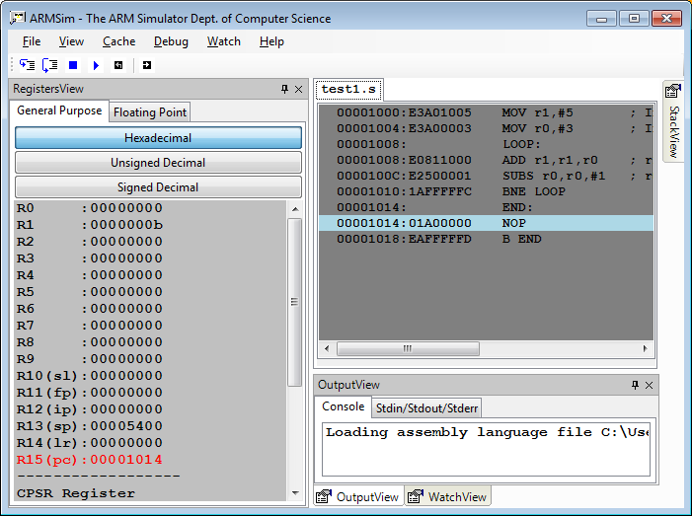
Ex 3: Understanding ARM Simulator UI
Once you successfully launch ARM Simulator
Go to “File” menu and using “Load” option, load test1.s file
Note: If the test1.s is not loaded it will not be possible to view the register contents.
Views
Registers
Instructions & Instruction Encoding
Menu items
(Note: Watch & Cache later)
Register
View
Code View
Output
View

Slide 14


Ex 4: User Mode Bank Registers
Observe the contents of r0 (R0) to r12 (R12)
R13 is Stack Pointer (SP)
R14 is Link Register (LR)
R15 is Program Counter (PC)
Current Process Status Register (PSR) is shown with its bit map
Correlate R15 content with Code View instruction address, and memory content in memory view
r0-r12,sp-um, lr-um, pc, cpsr
User mode (um)
Bank – 17 regs
General Purpose Registers (18) : r0 – r12, r8fm-r12fm (fm stands of FIQ Mode)
Stack Pointer (sp) (6): sp-xx
Link Register (lr) (6): lr-xx
Program Counter (1): pc
Current Program Status Register (1): cspr
Saved Program Status Register (5): spsr-xx

Slide 15
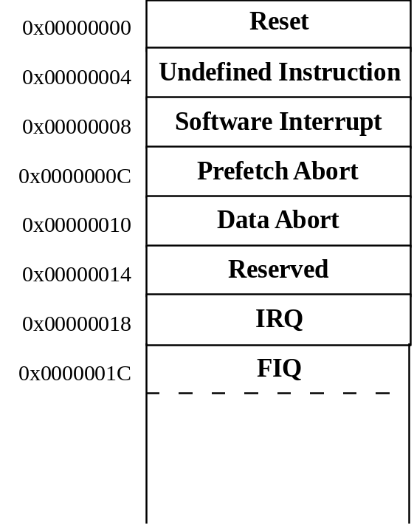
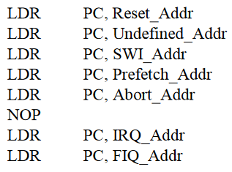
Exception Handling and the Vector Table
When an exception occurs, the core:
  Copies CPSR into SPSR_<mode>
  Sets appropriate CPSR bits (especially the mode)
  Maps in appropriate banked registers
  Stores the “return address” in LR_<mode>
  Sets PC to vector address
    For instance for Undefined instruction PC is set to 0x00000008
To return, exception handler needs to:
  Restore CPSR from SPSR_<mode>
  Restore PC from LR_<mode>
http://osnet.cs.nchu.edu.tw/powpoint/Embedded94_1/Chapter%207%20ARM%20Exceptions.pdf
Notes:
Exceptions, in order serviced, are:
Reset - supervisor mode
Data abort - abort mode
External Fast Interrupt Request - FIQ mode (eg DMA)
External Interrupt Request - IRQ mode
Instruction Prefetch abort - abort mode
Software Interrupt (SWI)- supervisor mode (typically used to extend operating system)
Undefined instruction - undefined mode
Only one memory location for each vector
Each vector contains branch to that particular exception handler
FIQ vector is last one. This allows its handler to be run sequentially from that address, removing need for branch and its associated delays. Important because speed is essential for FIQ.
Interrupt routine’s responsibility to clear interrupt condition.
Can return using one instruction
See exception handling module for details.

Slide 16
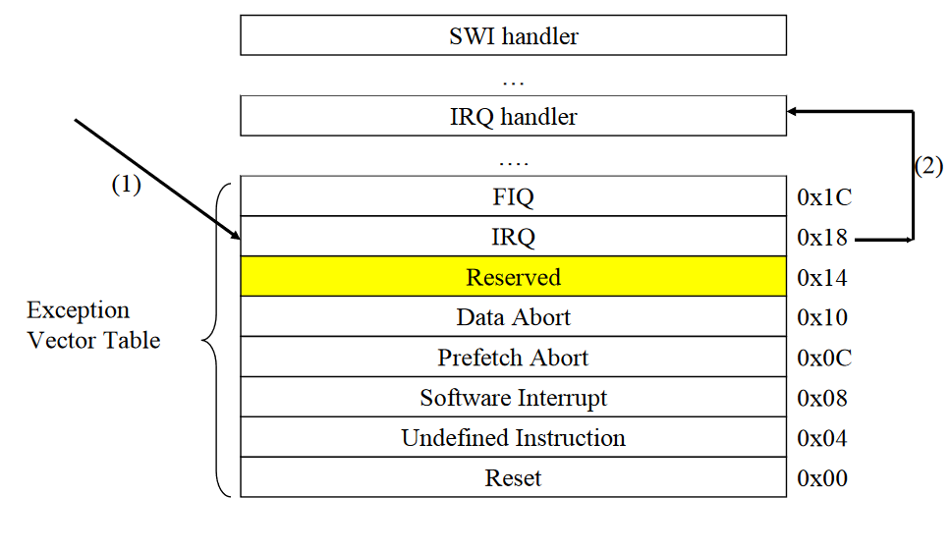
Memory Map
Memory map how the memory is organized
  Where the Vector Table is
  Where the handlers are
  Where OS tables are
  Where the user programs are loaded

Slide 17
Branching to Absolute Address
Load the PC with the absolute address of the instruction to be executed!
This could be done only in certain modes – example SWI (Supervisory)

Slide 18
The Instruction Pipeline
In order to increase the instruction throughput ARM uses a 3-stage pipeline
PC points to the instruction being fetched, rather than pointing to the instruction being executed.
Note: This will impact the relative addressing
Instruction fetched from memory
PC
FETCH
PC - 4
DECODE
Decoding of registers used in instruction
PC - 8
EXECUTE
Register(s) read from Register Bank
Shift and ALU operation
Write register(s) back to Register Bank
Notes:
Each instruction is one word (or 32 bits)
Thus each stage in pipeline is one word
In other words 4 bytes, hence the offsets of 4 and 8 used here.
Most instructions execute in a single cycle
Helps to keep the pipeline operating efficiently - only stalls if executing instruction takes several cycles.
Thus every cycle, processor can be loading one instruction, decoding another, whilst executing a third.
Typically the PC can be assumed to be current instruction plus 8
Cases when not case include
When exceptions taken the address stored in LR varies - see Exception Handling module for more details.
When PC used in some data processing operations value is unpredictable - see datasheet

Slide 19
Branching Instruction with Offset
The ARM supports B(ranch) instructions with offset address (rather than absolute address)
The target address to branch is computed at execution using an offset (actual offset/4) & Program Counter (PC) Value:
target address
= PC + offset *4;
= (branch instruction address + 8) + (offset << 2 )
Similarly the offset address can be computed from target and branch instruction addresses as follows:
  Offset
  = (target address – PC) << 2
  = (target address - (branch instruction address +8)) >> 2
FETCH
AND R1, R2
PC
PC - 4
DECODE
ADD R1, R2
EXECUTE
B +10
PC - 8
Notes:
Each instruction is one word (or 32 bits)
Thus each stage in pipeline is one word
In other words 4 bytes, hence the offsets of 4 and 8 used here.
Most instructions execute in a single cycle
Helps to keep the pipeline operating efficiently - only stalls if executing instruction takes several cycles.
Thus every cycle, processor can be loading one instruction, decoding another, whilst executing a third.
Typically the PC can be assumed to be current instruction plus 8
Cases when not case include
When exceptions taken the address stored in LR varies - see Exception Handling module for more details.
When PC used in some data processing operations value is unpredictable - see datasheet

Slide 20
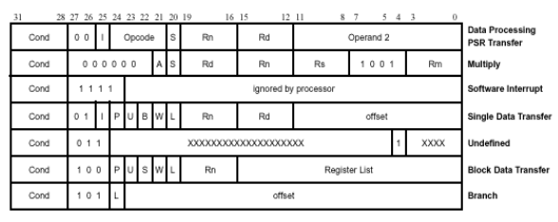
Instruction Encoding for Some ARM Instruction Types
Immediate Operand Bit
Notes:
Every instruction can be conditionally executed

Slide 21
Conditional Execution
Most processors allow only branches to be executed conditionally.
However by reusing the condition evaluation hardware, ARM effectively increases number of instructions.
  All instructions contain a condition field which determines whether the CPU will execute them.
  Non-executed instructions soak up 1 cycle.
    Still have to complete cycle so as to allow fetching and decoding of following instructions.
This removes the need for many branches, which stall the pipeline (3 cycles to refill).
  Allows very dense in-line code, without branches.
  The Time penalty of not executing several conditional instructions is frequently less than overhead of the branch or subroutine call that would otherwise be needed.

Slide 22
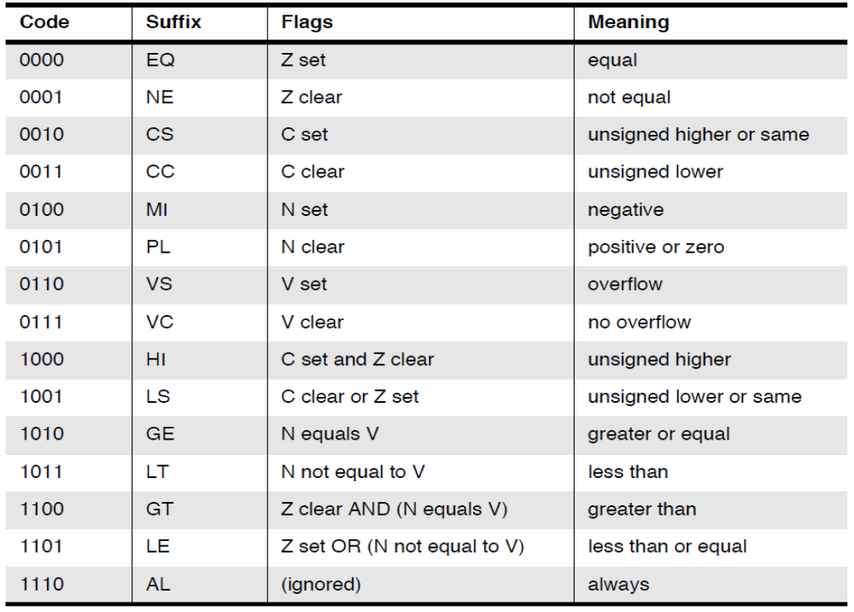
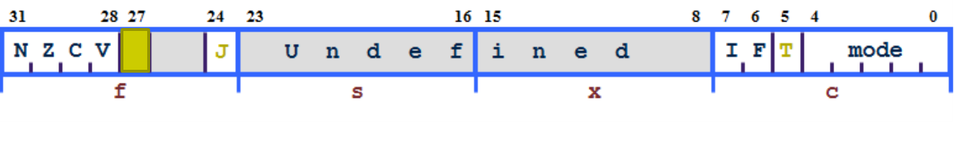
The Condition Field
31
28
24
20
16
12
8
4
0
Instruction
Cond
Instruction
CPSR
Notes:
4 bit Condition Field refers to the values of the appropriate bits in the CPSR, as indicated on slide.
Most instructions assembled with default condition code "always" (1110, AL).
This means the instruction will be executed irrespective of the flags in CPSR.
The "never" code (1111, NV) is reserved.
This family of conditions will be redefined for future use in other ARM devices.
Use MOV r0, r0 as NOP operation.
Conditional instructions aids code density
remove need for many branches (discussed earlier)

Slide 23
Using and updating the Condition Field
To execute an instruction conditionally, simply postfix it with the appropriate condition:
  For example an add instruction takes the form:
    ADD r0,r1,r2 ; r0 = r1 + r2 (ADDAL)
  To execute this only if the zero flag is set:
    ADDEQ r0,r1,r2 ; If zero flag set then r0 = r1 + r2
By default, data processing operations do not affect the condition flags (apart from the comparisons where this is the only effect).
To cause the condition flags to be updated, the S bit of the instruction needs to be set by postfixing the instruction (and any condition code) with an “S”.
  For example to add two numbers and set the condition flags:
    ADDS r0,r1,r2 ;
    r0 = r1 + r2 ; ... and set flags

Slide 24
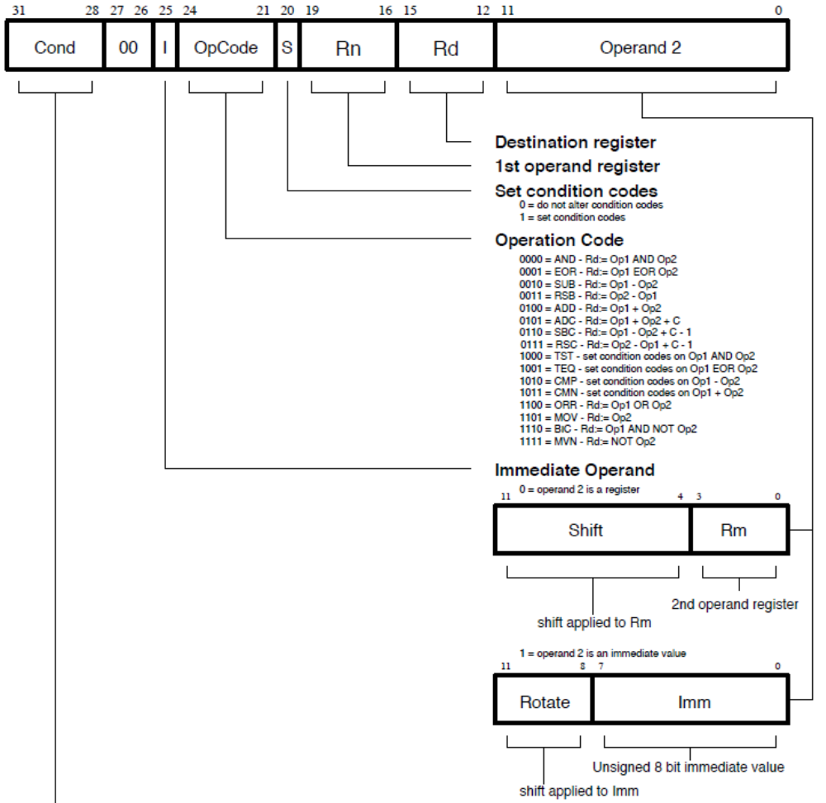
Ex 5: PC, Address, Memory & Instruction
Add r1, r1, r0
Binary representation of the above Add instruction
1110 00 0 0100 0 0001 0001 00000000 0000

Slide 25
Branch instruction
B{<cond>} label ; versus Branch with Link
The offset for branch instructions is calculated by the assembler:
  By taking the difference between the target instruction and the branch instruction address minus 8 (to allow for the pipeline). Then right shift the result by 2 positions.
  This gives a range of ± 32 Mbytes.
40
BEQ 100
44
31
28
27
25
24
23
0
48
Cond 1 0 1 L Offset
Link bit 0 = Branch
1 = Branch with link
Condition field
100
-------
104
…
Notes:
Branch instructions are PC-relative rather than absolute:
Branch instructions’ encoding contain a signed 2's complement 24 bit offset which is calculated by the assembler from the destination label given in the source code.

Slide 26
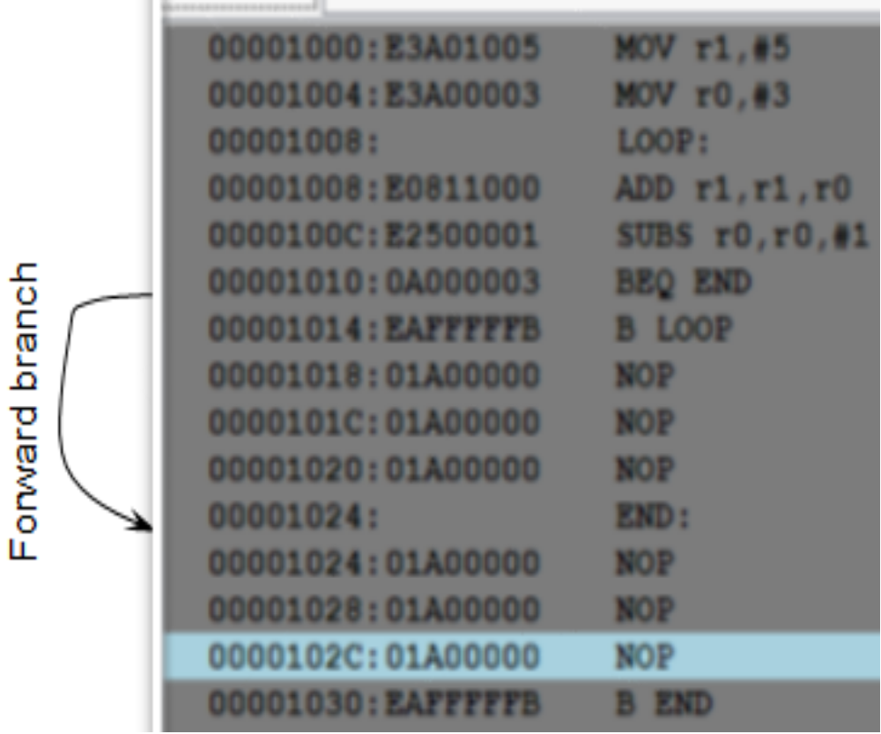
Ex 6: Branch Example (Forward Branch)
The target address to branch is computed as a function offset address with respect to Program Counter (PC) Value
target address
= PC + offset
= (branch instruction address + 8) + (offset << 2 )
Similarly the offset address can be computed from target and branch instruction addresses as follows:
  offset
  = (target address – PC) << 2
  = (target address - (branch instruction address +8)) >> 2
Branch Instruction address: 0x1010; Target Address: 0x1024
  Offset = ?
  Now using this offset and Branch instruction address find target address
Note: use test2.s
Test2.s
Notes:
+100 bytes from current instruction

Slide 27
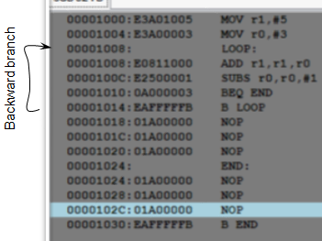
Ex 7: Branch Example (Backward Branch)
The target address to branch is computed as a function offset address with respect to Program Counter (PC) Value
target address
= PC + (offset address)
= (branch instruction address + 8) + (offset << 2 )
Similarly the offset address can be computed from target and branch instruction addresses as follows:
  offset
  = (target address – PC) << 2
  = (target address - (branch instruction address +8)) >> 2
Branch Instruction address: 0x1014; Target Address: 0x1008
  Offset = ?
  Now using this offset and Branch instruction address find target address
Notes:
+100 bytes from current instruction

Slide 28
Branch instruction with Link
Branch with Link : BL{<cond>} sub_routine_label
40
CALL 100
44
48
31
28
27
25
24
23
0
Cond 1 0 1 L Offset
Link bit 0 = Branch
1 = Branch with link
Condition field
100
-------
104
Sub-
Routine
…
RET
Notes:
Offset computation is similar to Branch instruction
Additionally, the "Branch with link" instruction implements a subroutine call by writing PC-4 into the LR of the current bank.
To return from subroutine, simply need to restore the PC from the LR:
The "Branch" instruction does not affect LR.
Branch instructions are PC-relative rather than absolute:
Branch instructions’ encoding contain a signed 2's complement 24 bit offset which is calculated by the assembler from the destination label given in the source code.

Slide 29
Data processing Instructions
Largest family of ARM instructions, all sharing the same instruction format.
Contains:
  Arithmetic operations
  Comparisons (no results - just set condition codes)
  Logical operations
  Data movement between registers
Remember, this is a load / store architecture
  These instruction only work on registers, NOT memory.
They each perform a specific operation on one or two operands.
  First operand always a register - Rn
  Second operand sent to the ALU via barrel shifter.
We will examine the barrel shifter shortly.

Slide 30
Arithmetic Operations
Operations are:
  ADD operand1 + operand2 ; operand1 is Rn
  ADC operand1 + operand2 + carry
  SUB operand1 - operand2
  SBC operand1 - operand2 + carry -1
  RSB operand2 - operand1
  RSC operand2 - operand1 + carry - 1
Syntax:
  <Operation>{<cond>}{S} Rd, Rn, Operand2 ; Rd is destination register
Examples
  ADD r0, r1, r2
  SUBGT r3, r3, #1
  RSBLES r4, r5, #5
Notes:
Usage
The ADD instruction adds the values in Rn and Operand2.
The SUB instruction subtracts the value of Operand2 from the value in Rn.
The RSB (Reverse SuBtract) instruction subtracts the value in Rn from the value of Operand2. This is useful because of the wide range of options for Operand2.
You can use ADC, SBC, and RSC to synthesize multiword arithmetic (see Multiword arithmetic examples).
The ADC (ADd with Carry) instruction adds the values in Rn and Operand2, together with the carry flag.
The SBC (SuBtract with Carry) instruction subtracts the value of Operand2 from the value in Rn. If the carry flag is clear, the result is reduced by one.
The RSC (Reverse Subtract with Carry) instruction subtracts the value in Rn from the value of Operand2. If the carry flag is clear, the result is reduced by one.
In certain circumstances, the assembler can substitute one instruction for another. Be aware of this when reading disassembly listings. See Instruction substitution for details.
Condition flags

Slide 31
Comparisons
The only effect of the comparisons is to
  UPDATE THE CONDITION FLAGS. Thus no need to set S bit.
Operations are:
  CMP operand1 - operand2, but result not written
  CMN operand1 + operand2, but result not written
  TST operand1 AND operand2, but result not written; Bitwise AND
  TEQ operand1 EOR operand2, but result not written; Bitwise EXOR
Syntax:
  <Operation>{<cond>} Rn, Operand2
Examples:
  CMP r0, r1
  TSTEQ r2, #5

Slide 32
Logical Operations
Operations are:
  AND operand1 AND operand2
  EOR operand1 EOR operand2
  ORR operand1 OR operand2
  BIC operand1 AND NOT operand2 [Bit Clear when operand2 = opearand1]
Syntax:
  <Operation>{<cond>}{S} Rd, Rn, Operand2 ; Rd ← Rn op Operand2
Examples:
  AND r0, r1, r2
  BICEQ r2, r3, #7
  EORS r1,r3, r0

Slide 33
Data Movement
Operations are:
  MOV Rd, operand2
  MVN Rd, NOT operand2
Note that these make no use of operand1. In other words, only 2 registers
Syntax:
  <Operation>{<cond>}{S} Rd, Operand2
Examples:
  MOV r0, r1
  MOVS r2, #10
  MVNEQ r1, #0

Slide 34
The Barrel Shifter
The ARM doesn’t have actual shift instructions.
Instead it has a barrel shifter which provides a mechanism to carry out shifts as part of other instructions.
Barrel shifter performs shift operations faster than regular shifter
So what operations does the barrel shifter support?

Slide 35
Barrel Shifter - Left Shift
Shifts left by the specified amount (multiplies by powers of two) e.g.
  LSL #5 = multiply by 32
CF is Carry Flag bit
Logical Shift Left (LSL)
CF
Destination
0
Notes:
Effectively x 2^{n.}
bits of operand shifted left by specified number of bits.
Zeros are inserted into the right most end of the word
last bit removed from the left most end placed in carry flag (CF).
LSL #0 does nothing and is the default shift if none is specified.

Slide 36
Barrel Shifter - Right Shifts
Logical Shift Right
Logical Shift Right
Shifts right by the specified amount (divides by powers of two) e.g.
LSR #5 = divide by 32
Arithmetic Shift Right
Shifts right (divides by powers of two) and preserves the sign bit, for 2's complement operations. e.g.
ASR #5 = divide by 32
Destination
CF
...0
Arithmetic Shift Right
Destination
CF
Sign bit shifted in
Notes:
LSR moves each bit of the register (Rm) to the right by the specified amount.
eg / LSR #5
all bits are moved 5 places to right (i.e. into less significant positions).
most significant positions then filled with zeros
least significant five bits of Rm are removed. The last of these five bits becomes the shifter Carry output, and may set the CPSR's C flag (when the ALU operation is in the logical class).
An LSR 0 is translated into an LSR 32, to put bit 31 of the word into the carry flag.
ASR similar to LSR except that
high bits are filled with bit 31 of Rm (the sign bit) instead of zeros.
This preserves the sign in 2's complement notation.
eg/
Divide a 2's complement number 10000010B (or -126) in Ra by 2.
MOV Ra, Ra, ASR #2
From Ra=10000010B we get RA=11000001B (or - 63)
An ASR #0 is translated into an ASR #32, to propagate bit 31 of the word into every bit in the word as well as the carry flag.

Slide 37
Barrel Shifter - Rotations
Rotate Right
Rotate Right (ROR)
• Similar to an ASR but the bits wrap around as they leave the LSB and appear as the MSB.
e.g. ROR #4
Note the last bit rotated is also used as the Carry Out.
Rotate Right Extended (RRX)
• This operation uses the CPSR C flag as a 33rd bit.
Rotates right by 1 bit. Encoded as ROR #0.
Destination
CF
Rotate Right through Carry
Destination
CF
Notes:
Rotate Right (ROR), and Rotate Right Extended (RRX) operations
used to manipulate the bits in a register without destroying those bits.
move each bit of the register (Rm) by the specified amount.
eg/ ROR #5
all bits moved 5 places to the right (i.e. into less significant positions).
However, rather than being discarded the bits shifted out are then rotated back to other high of the register
in ROR the bit previously at [0] is rotated to the MSB, [31]
In RRX - Carry flag included as a 33rd bit in the operation. Bit 0 becomes the Carry out, while the C becomes the MSB
RRX actually encoded as ROR #0
Example of use: in random number generator given in datasheet
.

Slide 38
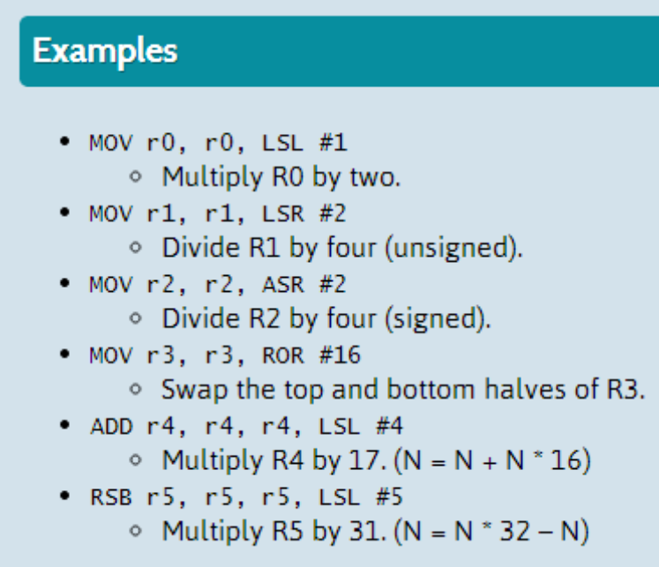
Using the Barrel Shifter: The Second Operand
Operand 1
Operand 2
Register, optionally with shift/ROR operation applied.
Shift range is 0 to 31
ROR range 2,4,6, …, 30
Barrel Shifter
Immediate value
ALU
Result

Slide 39
Ex - Using Shifted Register
Using a multiplication instruction to multiply by a constant means first loading the constant into a register and then waiting a number of internal cycles for the instruction to complete.
A more optimum solution can often be found by using some combination of MOVs, ADDs, SUBs and RSBs with shifts.
  Multiplications by a constant equal to a ((power of 2) ± 1) can be done in one cycle.
Example: r0 = r1 * 5 ; MUL R1, R1, #5
Example: r0 = r1 + (r1 * 4)
⇦ ADD r0, r1, r1, LSL #2
Example: r2 = r3 * 105
Example: r2 = r3 * 15 * 7
Example: r2 = r3 * (16 - 1) * (8 - 1)
⇦ RSB r2, r3, r3, LSL #4 ; r2 = r3 * 15
⇦ RSB r2, r2, r2, LSL #3 ; r2 = r2 * 7
Notes:
Main use for a shifted register is to provide inline multiplication (and division)
Using one or more instructions with shifted registers.
This can often be quicker than using MUL instruction, though not as flexible.
Need to know constant at compile / assemble time.
The problem of finding the optimum sequence becomes more difficult as constant becomes larger.
No known algorithm to solve this problem quickly.
C compiler restricts amount of searching it does in order to minimise impact on compile time
Has cut-off so that uses normal MUL once number of instructions used in squence passes a limit.
Sequences could otherwise become very long.

Slide 40
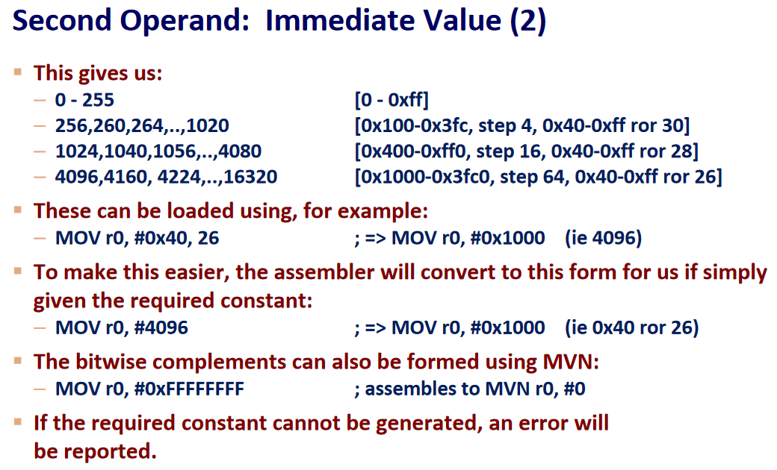
Large constants with limited size of Immediate Value
Immediate operand size is 12 bits.
Out of this, the least significant 8 bits are used for constant value
Rest of the 4 bits are used of ROR
Value 1 in these bits code ROL 2
Value 2 in these bits code ROL 4
…
Value 15 in these bits code ROL 30
Notes:
8 bits for data
4 bits for rotation – 0 to 15, 0 is 0, 1 is 2, 2 is 4, 3 is 6, and 15 is 30
Only those even numbered RORs are permitted
Note ROR 30 is same ROL (32-30) for a 32 bit register
With 8 bit immediate constants ROR of 0 we have values 0 to 255
With 8 bit immediate constants ROL of 2 we have values some overlapping values up to 63, then unique values starting from 64 (0X40) – 0x100 to 0X3FC
With 8 bit immediate constants ROL of 4 we have values some overlapping values up to 63, then unique values starting from 0X40 – 0X400 – 0Xff0
…

Slide 41
Notes
ROR 30 is same ROL (32-30)
ROR 0 gives us constants 0 – 255
ROR 30 or ROL 2 gives constants 256, 260, … 1020
ROR 28 or ROL 4 gives constants 1024, 1040, … , 4080
ROR 26 or ROL 6 gives constants 4096, 4128, … , 10208

Slide 42
Load / Store Instructions
The ARM is a Load / Store Architecture:
  Does not support memory to memory data processing operations.
  Must move data values into registers before using them.
This might sound inefficient, but in practice isn’t:
  Load data values from memory into registers.
  Process data in registers using a number of data processing instructions which are not slowed down by memory access.
  Store results from registers out to memory.
The ARM has three sets of instructions which interact with main memory. These are:
  Single register data transfer (LDR / STR).
  Block data transfer (LDM/STM).
  Single Data Swap (SWP).
Notes:
All instructions other than these can only use values in registers

Slide 43
Single register data transfer
The basic load and store instructions are:
  Load and Store Word or Byte
    LDR / STR / LDRB / STRB
ARM Architecture Version 4 also adds support for halfwords and signed data.
  Load and Store Halfword
    LDRH / STRH
  Load Signed Byte or Halfword - load value and sign extend it to 32 bits.
    LDRSB / LDRSH
All of these instructions can be conditionally executed by inserting the appropriate condition code after STR / LDR.
  e.g. LDREQB
Syntax:
  <LDR|STR>{<cond>}{<size>} Rd, <address>

Slide 44
Load and Store
The memory location to be accessed is held in a base register
  STR r0, [r1] ; Store contents of r0 to location pointed to
  ; by contents of r1.
  LDR r2, [r1] ; Load r2 with contents of memory location
  ; pointed to by contents of r1.
r0
Memory
Source
Register
for STR
0x5
r1
r2
Base
Register
0x200
Destination
Register
for LDR
0x200
0x5
0x5

Slide 45
Exercise
Write ARM code snippet that store some data in 5 consecutive words (starting from memory address 0x2000) and retrieve those 5 words into a register

Slide 46
Load and Store with Indexing
As well as accessing the actual location contained in the base register, these instructions can access a location offset from the base register pointer.
This offset can be
  An unsigned 12bit immediate value (ie 0 - 4095 bytes).
  A register, optionally shifted by an immediate value
This can be either added or subtracted from the base register:
  Prefix the offset value or register with ‘+’ (default) or ‘-’.
This offset can be applied:
  before the transfer is made: Pre-indexed addressing
    optionally auto-incrementing the base register, by postfixing the instruction with an ‘!’.
  after the transfer is made: Post-indexed addressing
    causing the base register to be auto-incremented.

Slide 47
Load and Store Word Pre-indexed Addressing
r0
Source
Register
for STR
Memory
Example: STR r0, [r1,#12]!
To store to location 0x1f4 instead use: STR r0, [r1,#-12]!
To auto-increment base pointer to 0x20c use: STR r0, [r1, #12]!
Immediate operand can be a shifted Register!
0x5
Offset
12
0x20c
0x5
r1
Base
Register
0x200
0x200

Slide 48
Load and Store Word Post-indexed Addressing
Example: STR r0, [r1], #12
To auto-increment the base register to location 0x1f4 instead use:
  STR r0, [r1], #-12
Memory
Updated
Base
Register
r1
Offset
r0
Source
Register
for STR
0x20c
12
0x20c
0x5
r1
0x200
0x5
Original
Base
Register
0x200

Slide 49
Code Snippets Pre-Indexing and Post-Indexing
Develop ARM assembly code snippet that does Pre-indexing and Post-indexing. Demonstrate this with ARM Simulator
Use Data Cache for various Block size to show how mis-rate decreases with larger block size
Also justify the hit and miss count for instruction cache

Slide 50
Swap Instructions
Atomic operation of a memory read followed by a memory write which moves byte or word quantities between registers and memory.
Syntax:
  SWP{<cond>}{B} Rd, Rm, [Rn]
Thus to implement an actual swap of contents make Rd = Rm.
The compiler cannot produce this instruction.
Interrupting an Instruction
1
Rn
temp
2
3
Memory
Rm
Rd
Notes:
Used to move a byte or word quantity from a source register (Rm) to external memory, located by base register Rn
Stores the old memory contents in the destination register (Rd).
Instruction is indivisible - LOCK output goes high to signify to an external MMU or processors that the instruction is uninterruptable.
SWP is used to implement semaphores providing a mutual exclusion between the processor and other devices trying to access memory - originally added by Acorn for use in a multiprocessor system.

Slide 51
Software Interrupt (SWI)
31
28
27
24
23
0
Cond
1 1 1 1
Comment field (ignored by Processor)
In effect, a SWI is a user-defined instruction.
It causes an exception trap to the SWI hardware vector (thus causing a change to supervisor mode, plus the associated state saving), thus causing the SWI exception handler to be called.
The handler can then examine the comment field of the instruction to decide what operation has been requested.
By making use of the SWI mechanism, an operating system can implement a set of privileged operations which applications running in user mode can request.
See Exception Handling Module for further details.

Slide 52
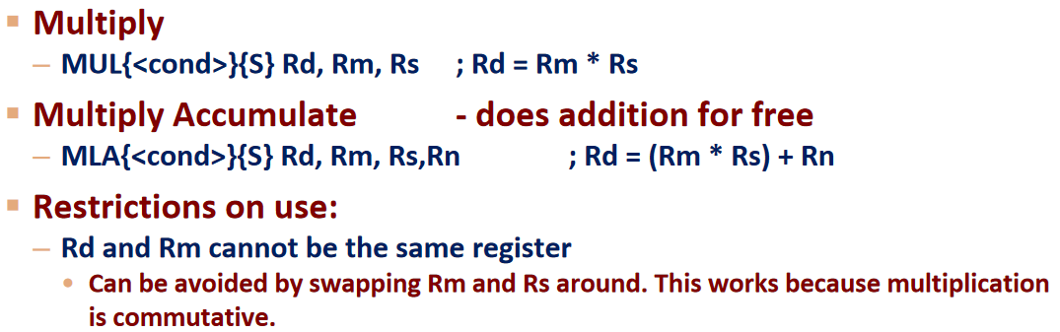
Multiplication Instruction
ARM implement Booth’s algorithm for multiplication
Long and Accumulate options are supported
Syntax for non-long multiplication:

Slide 53
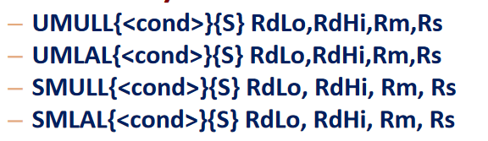
Syntax for Long Multiplication
64 bit result
Unsigned Long and Accumulate
Signed Long and Accumulate

Slide 54
Exception Handling and the Vector Table
When an exception occurs, the core:
  Copies CPSR into SPSR_<mode>
  Sets appropriate CPSR bits
  Maps in appropriate banked registers
  Stores the “return address” in LR_<mode>
  Sets PC to vector address
    For instance for Undefined instruction PC is set to 0x00000008
To return, exception handler needs to:
  Restore CPSR from SPSR_<mode>
  Restore PC from LR_<mode>
Notes:
Exceptions, in order serviced, are:
Reset - supervisor mode
Data abort - abort mode
External Fast Interrupt Request - FIQ mode (eg DMA)
External Interrupt Request - IRQ mode
Instruction Prefetch abort - abort mode
Software Interrupt (SWI)- supervisor mode (typically used to extend operating system)
Undefined instruction - undefined mode
Only one memory location for each vector
Each vector contains branch to that particular exception handler
FIQ vector is last one. This allows its handler to be run sequentially from that address, removing need for branch and its associated delays. Important because speed is essential for FIQ.
Interrupt routine’s responsibility to clear interrupt condition.
Can return using one instruction
See exception handling module for details.

Slide 55
Assembler Directives (2)
Hello: .asciz "Hello Class\n“
.equ SEG_A, 0x80
.equ Ten, 10
.set counter,1
.set counter,counter+1
Reference: https://community.arm.com/processors/b/blog/posts/useful-assembler-directives-and-macros-for-the-gnu-assembler

Slide 56
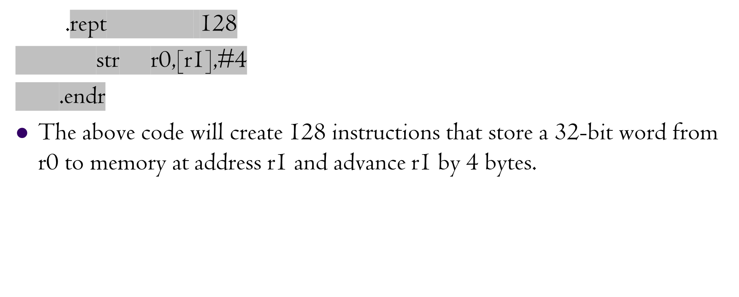
Assembler Directive (2)

Slide 57
Revising SWI
SWI is software Interrupt instruction
We will use this interrupt to call I/O handling plugins
SWI instruction format
The value in the comment field is used by the SWI handler to perform various different I/O for ARMSIM
31
28
27
24
23
0
Cond
1 1 1 1
Comment field (ignored by Processor)

Slide 58
SWI – ARMSIM Specific I/O
There are two plugins with ARMSIM
  Basic I/O Plugin
    File I/O
    Memory management
  Embest Board Plugin
    LED
    Keypad
    Buttons
    LED Number Segment

Slide 59
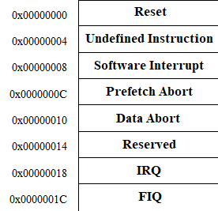
SWI Operation
When SWI is executed the Core:
  Copies CPSR into SPSR_<mode>
  Sets appropriate CPSR bits
  Maps in appropriate banked registers
  Stores the “return address” in LR_<mode>
  Sets PC to vector address
    PC is set to 0x00000008 (example)
    There is BR instruction there to SWI handler
To return, SWI handler needs to:
  Restore CPSR from SPSR_<mode>
  Restore PC from LR_<mode>
Exception Vector Table

Slide 60
What is not discussed?
Block Transfer
Writing C code, Compiling it for ARM
ARM and Thumb coexistence

